Slide 1
The Professional Indemnity Insurance Policy and the Insurance Act 2015
Robert Lloyd

Slide 2
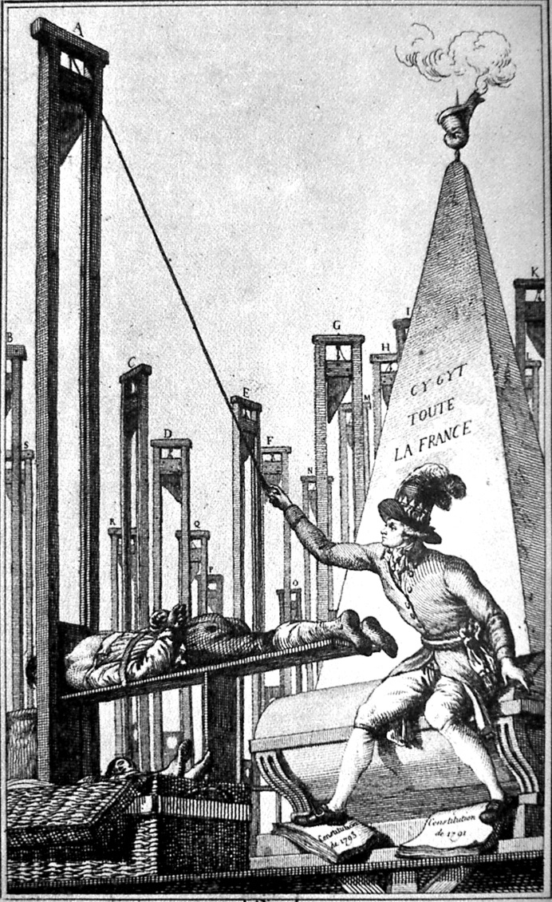
“Plus ça change, plus c’est la même chose.”
“The king is dead, long live the king!

Slide 3
The Major Changes
A Duty of Fair Presentation (Section 3);
Specified Remedies for Breach of Condition;
Restrictions on Insurers’ Reliance on Warranties (Sections 9 and 10);
Fraudulent Claims (Section 12 and 13);
Contracting Out (Sections 15—18); and
Third Party (Rights Against Insurers) Provisions (Section 19).

Slide 4
What the Insurance Act does not touch
The Cover;
The Limits and the Excess;
The Exclusions; and
The Premium.

Slide 5
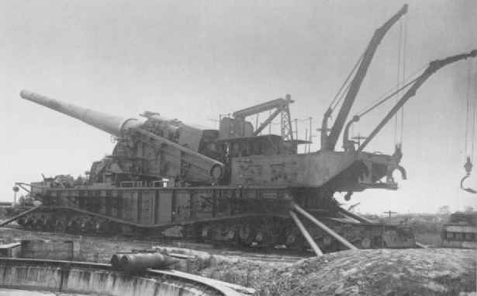
The Insurers’ Big Guns
The Basis Clause;
Breach of Warranty;
Misrepresentation and Non-Disclosure;
Breach of the Duty of Utmost Good Faith; and
Breach of Conditions Precedent to Liability.
The Clive Boxer

Slide 6
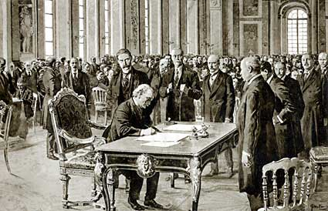
The Balance of Power
The Law;
Innocent Non-Disclosure;
Minimum Terms; and
Commercial Reality.
Signing of the first SRA Minimum Terms

Slide 7
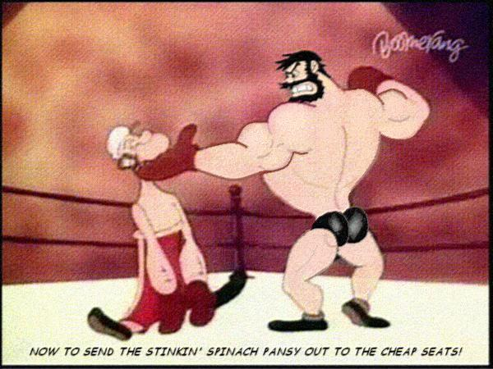
Elimination of the Basis Clause
Insurers, in consideration of payment of the Premium and in reliance upon the statements and information provided by the Policyholder prior to the date this Policy commences, which it is agreed forms the basis of and is incorporated into this Policy, agree to indemnify the Policyholder subject to the terms, exclusions, conditions, limitations, and endorsements of this Policy.

Slide 8
Duty of Fair Presentation
…disclosure of every material circumstance which the Insured knows or ought to know, or which gives the Insurer sufficient information to put a prudent Insurer on notice that it needs to make further enquiries for the purpose of revealing those material circumstances. Such disclosure is to be in a manner which would be reasonably clear and accessible to a prudent insurer and in which every material representation as a matter of fact is substantially correct, and every material representation as to a matter of expectation or belief is made in good faith.
Section 3 Insurance Act (Paraphrased)

Slide 9
Qualifying Breaches of Duty of Fair Presentation
Deliberate or reckless; or
Not deliberate or reckless; and
Insurer would not have entered into the contract or done so on different terms
Then remedies in Schedule 1.
Avoid and keep premium
Avoid and return premium
Apply different terms or reduce indemnity

Slide 10
Innocent Non-Disclosure
No avoidance or rejection of indemnity on account of:
Non-disclosure of facts;
Misrepresentation of facts;
Incorrect particulars;
Late notification of claims and circumstances,
Provided it was innocent and free of fraudulent conduct or intent.
Conduct or breach or non-compliance with conditions giving rise to prejudice in the handling of settlement of a claim reduces indemnity to that payable in the absence of prejudice.

Slide 11
Breach of Conditions/Prejudice Defined
Non-compliance with any condition that would tend to increase the risk of one or more of the following:
Loss of a particular kind;
Loss at a particular location;
Loss at a particular time,
And a loss occurs
And the Insured cannot show that the breach or non-compliance could not have increased the risk of the loss which actually occurred in the circumstances in which it occurred.
Section 11 (paraphrased)

Slide 12

Minimum Terms
Insurer seeks reimbursement from a sole practitioner solicitor

Slide 13
Warranties
The Insurer can only rely on a warranty to refuse liability for a loss occurring, or attributable something happening, prior to the breach of warranty being remedied (section 10(2)).
The Insurer cannot rely on a breach of warranty if the warranty is no longer applicable to the circumstances of the policy, because of a change in circumstances, or if unlawful, or if the Insurer waives the breach (section 10(3)).
The Insurer is liable for losses occurring, or attributable to something happening, before the breach or after the Insured is no longer in breach or if the risk is essentially the same as that originally contemplated (section 10(4) and 10(5)).

Slide 14

Fraudulent Claims
Section 12 Insurance Act 2015 applied

Slide 15


Conclusion
Key Date: 12th August 2016
7 weeks until solicitors’ renewal.

Slide 16
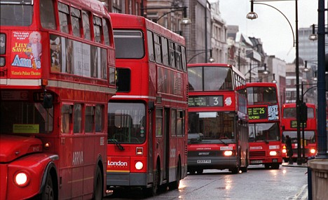
Coming Next…
Enterprise Act 2016
Claims must be paid “within a reasonable time”
Insurance Act 2015 Amended.

Slide 17
The Professional Indemnity Insurance Policy and the Insurance Act 2015
Robert Lloyd

